Slide 1
Project Management Internship
Ronit Tonknogy VC1C
ronit324@gmail.com
Group 30

Slide 2
About Northwell Health
My employer for this internship is Northwell Health.
Northwell Health is New York State’s largest healthcare provider and private employer, with 21 hospitals, about 900 outpatient facilities and more than 12,000 affiliated physicians.
Northwell cares for over two million people annually in the New York metro area and beyond.

Slide 3
Internship Duration
I started the Internship in June 2023, and currently I’m working part time in my role.
The internship was just renewed and for now i’ll be working with them with no expected end date.

Slide 4
Why I chose this internship
I major in Information systems and psychology, and the natural career path for me was project/ product management. I aspire to become a professional in these fields.
I enjoy working with technology and thinking about new solutions.

Slide 5
Daily tasks:
Documentation Preparation:
Create and maintain process flows, business requirements, functional specifications, and user guides
Develop and update test scripts for various projects.

Slide 6
More daily tasks:
Test Execution and Data Validation:
Execute test scripts to ensure functionality and performance.
Perform thorough data validation to maintain data integrity.

Slide 7
More daily tasks:
Stakeholder Assistance:
Collaborate with business analysts, project managers, and developers on incoming tasks.
Provide support for clients and real estate PMs regarding technical requests and troubleshoot issues.

Slide 8
More daily tasks:
Report Preparation:
Compile and prepare detailed reports for various stakeholders.
Design dynamic Excel reports, integrating VLOOKUP and Pivot tables, identifying patterns and trends to optimize business strategies and drive performance enhancements.
Use dynamic tools and techniques to enhance report accuracy and insight.

Slide 9
More daily tasks:
SQL Queries:
Craft and execute SQL queries to extract and manipulate data for analysis.

Slide 10
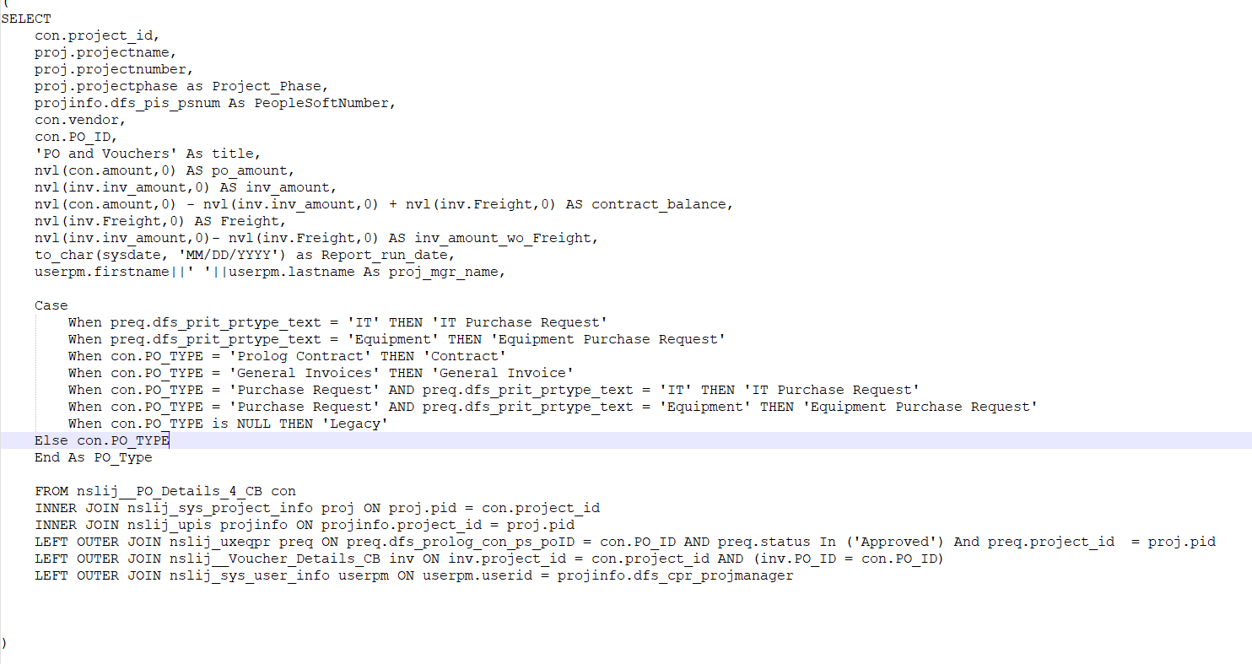
Example of a query I worked On:

Slide 11
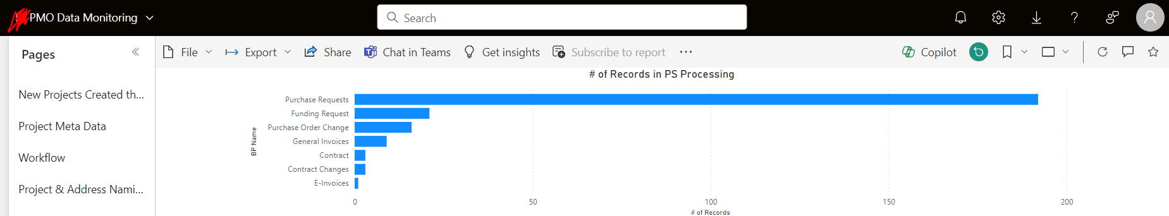
More daily tasks:
PowerBI:
Oversee Power BI dashboards and reports to deliver key insights for decision support and data analysis.

Slide 12
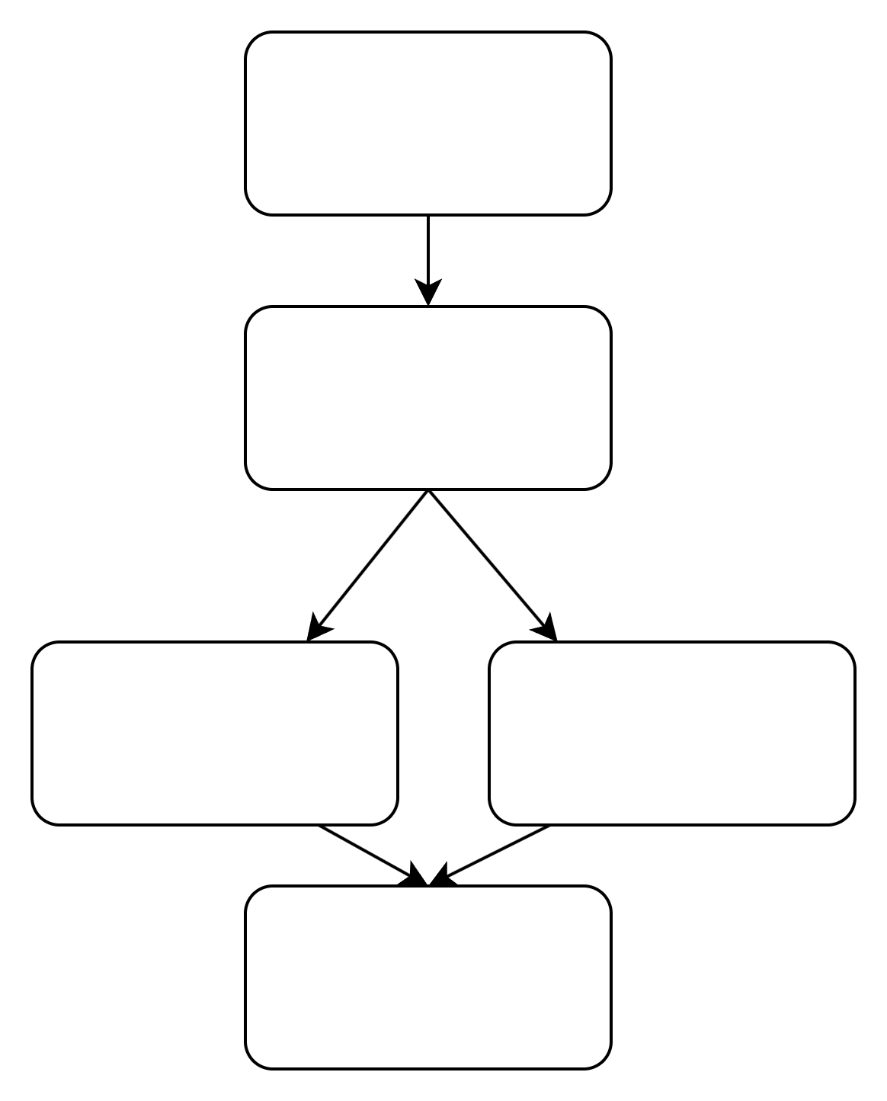
My Team’s Structure
Program Manager
Lead Project Manager
Business Analyst
Business Analyst
Project Management Intern - Me

Slide 13
Team Members’ Responsibilities
All roles collaborate and interact with each other.
The Program Manager makes sure everyone is meeting their deliverables, oversees the team, and provides guidance.

Slide 14
Team Members’ Responsibilities
All roles collaborate and interact with each other.
The Lead Project Manager is responsible for most of the project’s documentation and communication with clients.

Slide 15
Team Members’ Responsibilities
All roles collaborate and interact with each other.
The Business analysts are in charge of reports, development, tests, technical support, and support requests.

Slide 16
Team Members’ Responsibilities
All roles collaborate and interact with each other.
The Project Management Intern is working with all team members, shadowing and completing tasks.

Slide 17
Skills I honed during the program:
Collaboration Skills
Teamwork: Enhanced ability to work collaboratively within an interdisciplinary team.
Communication: Improved communication skills through regular interactions with business analysts, project managers, and developers.
Problem-Solving: Developed problem-solving skills by assisting stakeholders with various technical support requests and project tasks.

Slide 18
Skills I honed during the program:
Corporate Environment
Professionalism: Gained insights into maintaining professionalism in a corporate setting.
Work Ethic: Developed a strong work ethic by balancing multiple responsibilities and deadlines.
Corporate Culture: Understood the dynamics of corporate culture and the importance of aligning with organizational values.

Slide 19
Skills I honed during the program:
Stakeholder Management
Requirements Gathering: Learned to gather and establish business requirements through interaction with various stakeholders.
Reporting: Developed skills in preparing detailed and insightful reports for stakeholders.
Feedback: Valued the importance of incorporating feedback from stakeholders to improve project outcomes.

Slide 20
Skills I honed during the program:
Technical Skills
Excel Proficiency: Improved Excel skills, including advanced functions like VLOOKUP and Pivot tables.
SQL Queries: Enhanced ability to craft and execute complex SQL queries for data extraction and analysis.
Power BI: Gained experience in using Power BI to create dashboards and reports for data-driven decision-making.

Slide 21
Final updates
I feel that I have immersed myself in the team, learned how to approach tasks independently and I feel comfortable working on every incoming task on my own. In March, my manager spoke with me about my objectives for the future. She told me that she is very happy with my work, my expertise in testing, my ability to grasp new information quickly, my adaptability, and the way I engage and get along with my colleagues. I have been offered a full-time position with Northwell Health. Currently, I am still waiting for the budget to get approved. I’m very grateful for this opportunity and excited for the future!

Slide 22
Resources and links
GitHub Repository: https://github.com/RonitTonko/4900
Project Board: https://github.com/users/RonitTonko/projects/1

